Slide 1

Digital Image Processing
Dr. Mubashir Ahmad (Ph.D.)

Slide 2
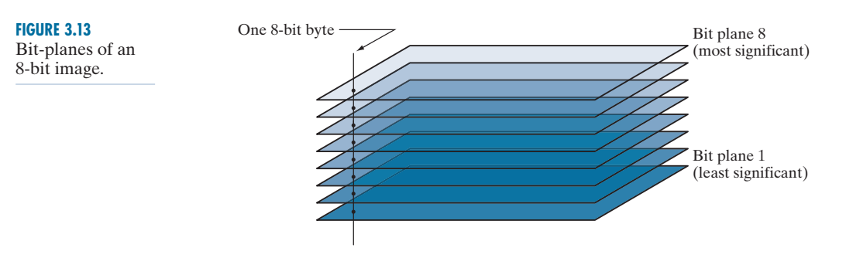
Bit-Plane Slicing
Pixel values are integers composed of bits. For example, values in a 256-level grayscale image are composed of 8 bits (one byte). Instead of highlighting intensity-level ranges, as 3.3, we could highlight the contribution made to total image appearance by specific bits. As Fig. 3.13 illustrates, an 8-bit image may be considered as being composed of eight one-bit planes, with plane 1 containing the lowest-order bit of all pixels in the image, and plane 8 all the highest-order bits.

Slide 3
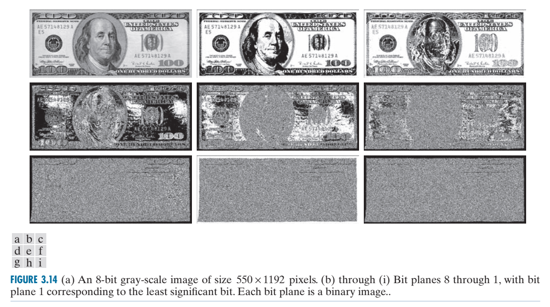
Bit-Plane Slicing

Slide 4
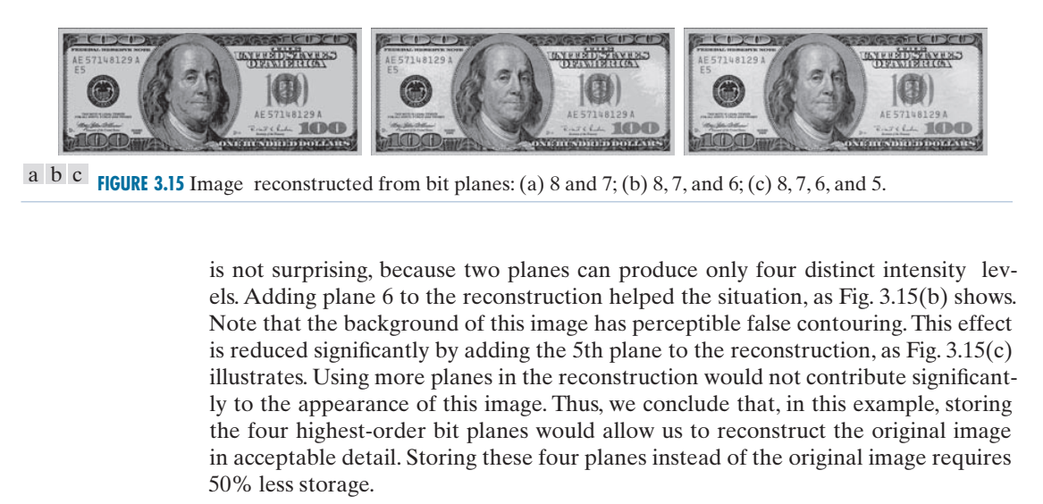
Bit-Plane Slicing

Slide 5
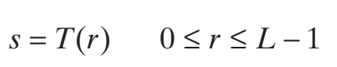
HISTOGRAM EQUALIZATION
Assuming initially continuous intensity values, let the variable r denote the intensities of an image to be processed. As usual, we assume that r is in the range [0 , L - 1]. with r = 0 representing black and r = L - 1 representing white.
that produce an output intensity value, s, for a given intensity value r in the input image. We assume that..
(a) T (r ) is a monotonic increasing function in the interval 0 ≤ r ≤ L -1; and
(b) 0 ≤ T (r ) ≤ L - 1 for 0 ≤ r ≤ L - 1.

Slide 6
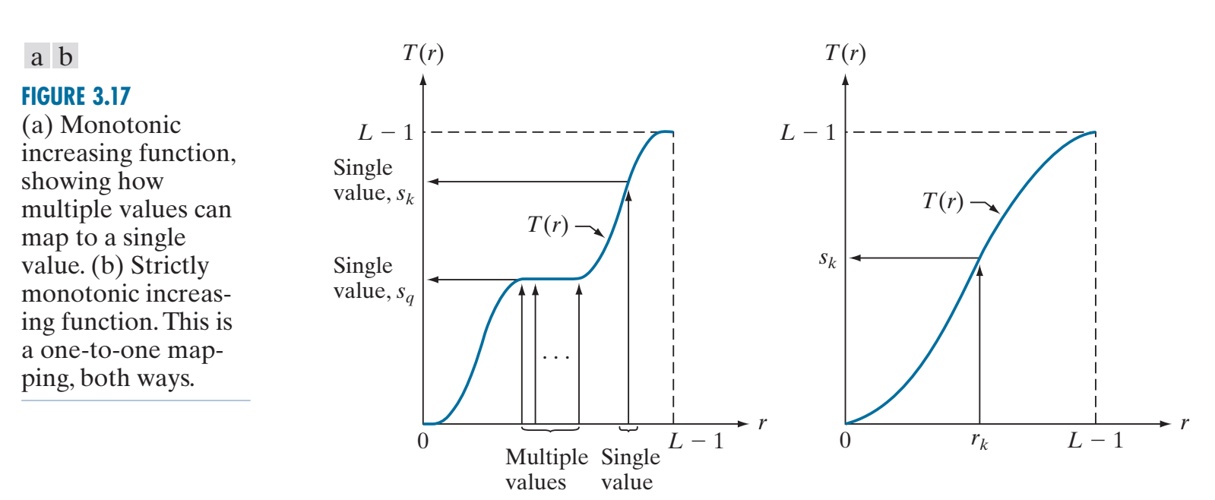
HISTOGRAM EQUALIZATION

Slide 7
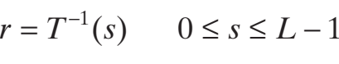
HISTOGRAM EQUALIZATION
In some formulations to be discussed shortly, we use the inverse transformation
in which case we change condition (a) to: (a’) T (r) is a strictly monotonic increasing function in the interval 0 ≤ r ≤ L – 1.

Slide 8
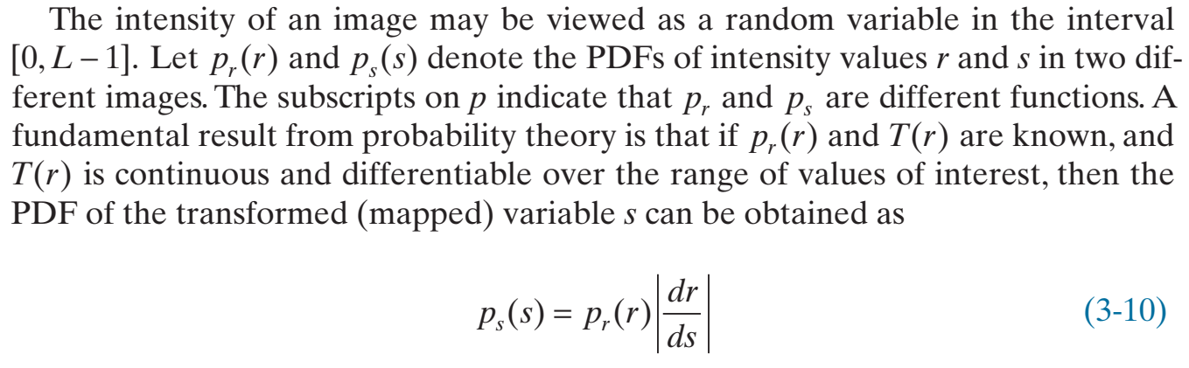






















HISTOGRAM EQUALIZATION

Slide 9
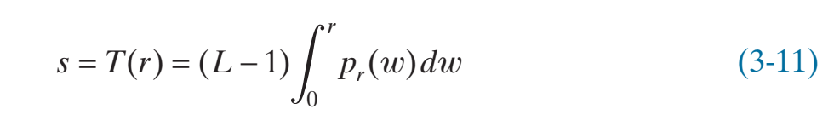
HISTOGRAM EQUALIZATION
where w is a dummy variable of integration. The integral on the right side is the cumulative distribution function (CDF) of random variable r. Because PDFs always are positive, and the integral of a function is the area under the function, it follows that the transformation function of Eq. (3-11) satisfies condition (a). This is because the area under the function cannot decrease as r increases.

Slide 10
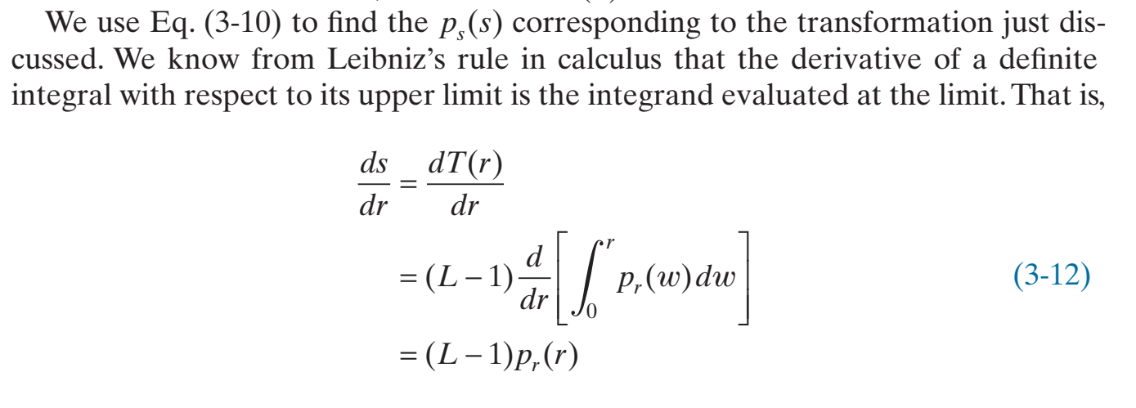












HISTOGRAM EQUALIZATION

Slide 11
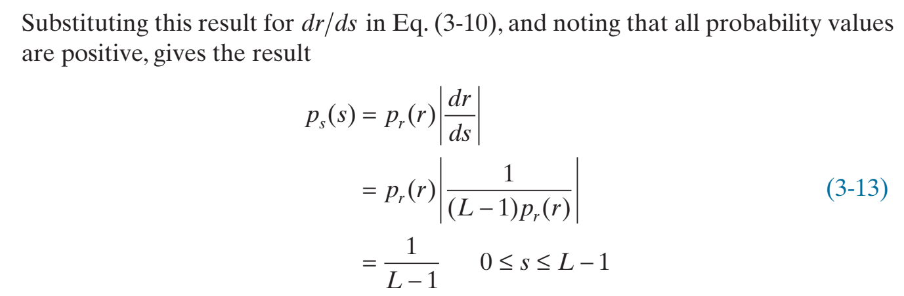


HISTOGRAM EQUALIZATION

Slide 12
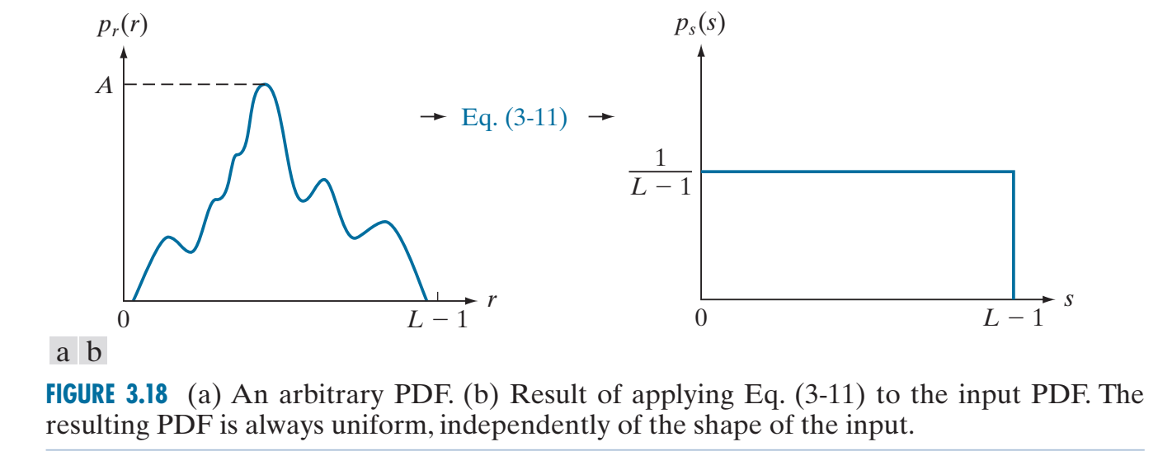
HISTOGRAM EQUALIZATION

Slide 13
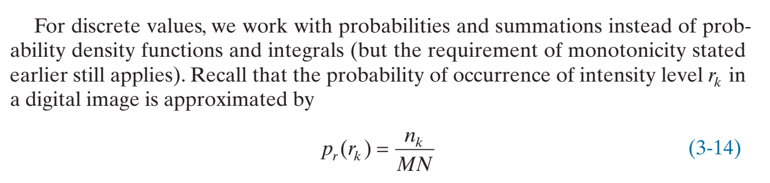
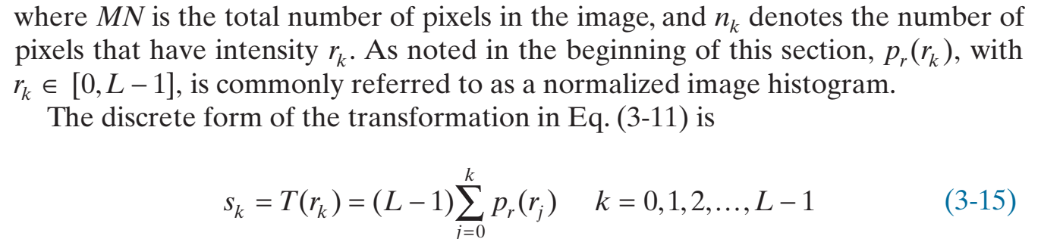
HISTOGRAM EQUALIZATION

Slide 14
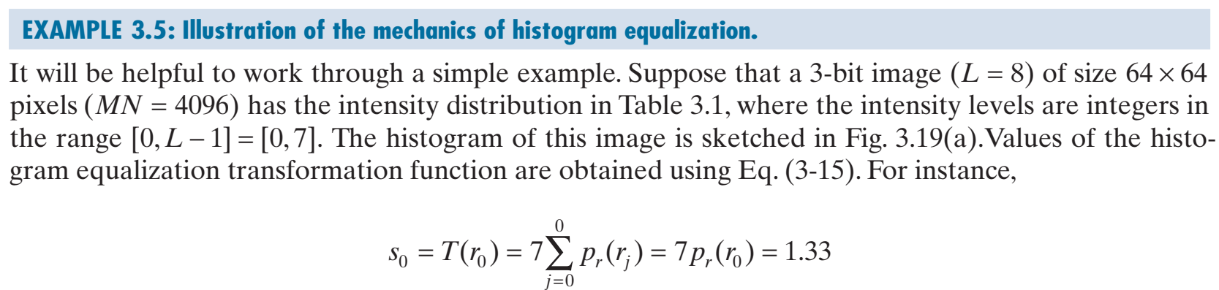
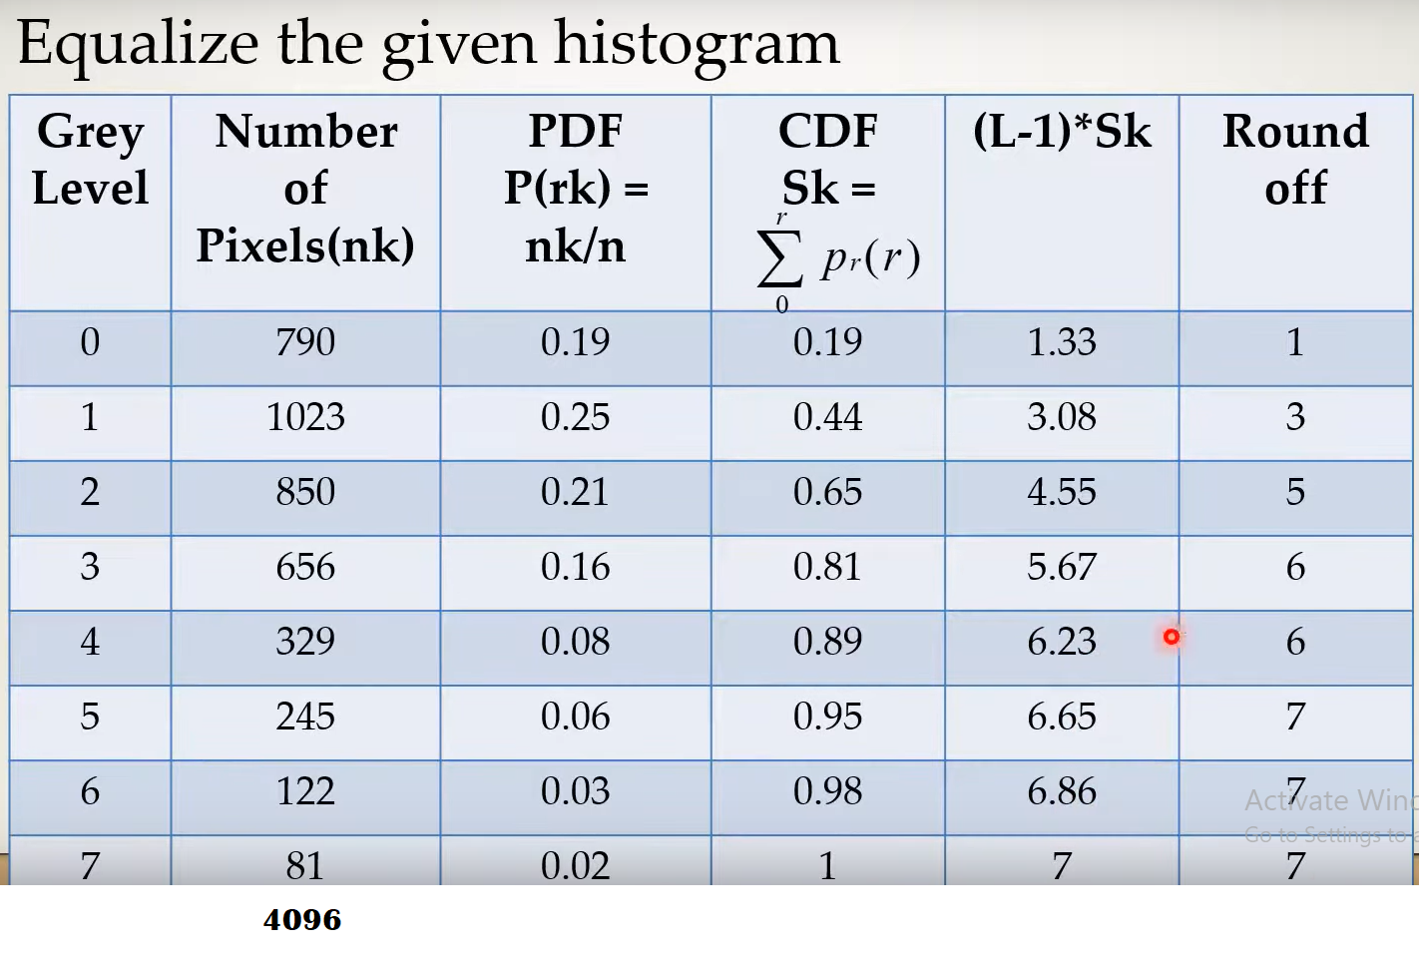

Slide 15
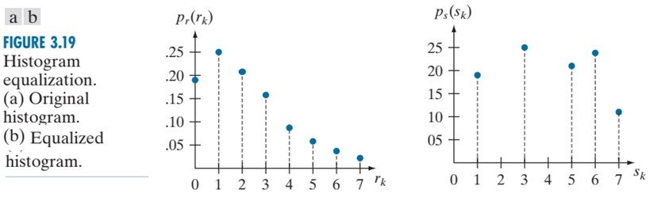
HISTOGRAM EQUALIZATION

Slide 16
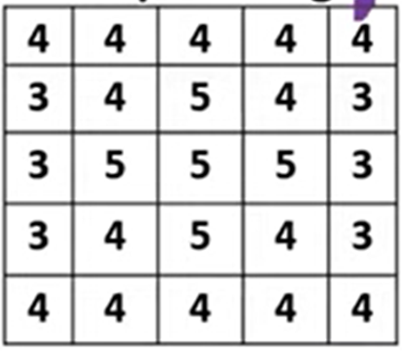
Solve histogram equalization of 3-Bit Image?

Slide 17
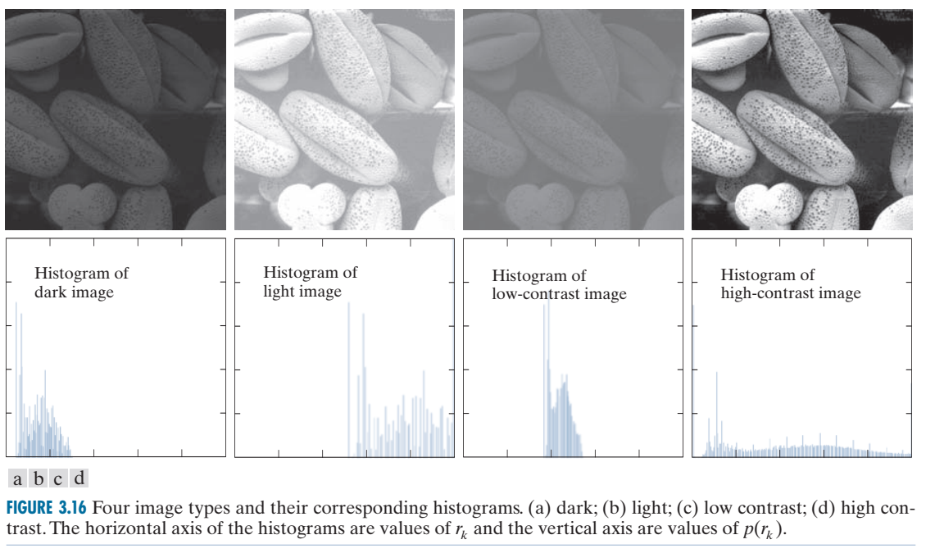

Slide 18
